Slide 1
Integrated transcriptomic analysis identifies a prognostic immune-exclusion signature in colorectal adenocarcinoma
Name: vinay Gundala
MSc Bioinformatics
supervisor: Dr. swetha kuba
date

Slide 2
Clinical / Biological Motivation
CRC is heterogeneous; immune contexture strongly influences survival and therapy response
Immune exclusion = low immune infiltration + stromal/ECM barrier → poor outcomes
Need signatures that generalize across cohorts and platforms

Slide 3
Datasets
Discovery
TCGA-COAD + TCGA-READ
Data: RNA-seq, clinical survival
Used for immune scoring, DE, model training
Validation
GSE39582 (GPL570 microarray)
Large independent cohort + long follow-up
Cross-platform test of robustness

Slide 4
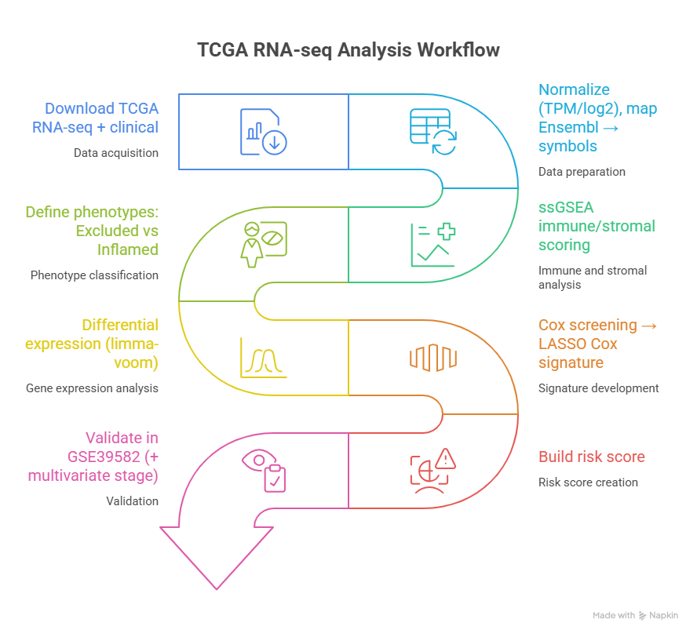

Slide 4 — Workflow Overview

Slide 5
Immune phenotype definition (ssGSEA)
Immune infiltration gene set (10 genes)
Stromal/ECM barrier gene set (12 genes)
Quartile-based definition:
Immune Excluded = immune low (Q1) + stromal high (Q4)
Immune Inflamed = immune high (Q4) + stromal low (Q1)
Report your counts:
Immune_Excluded: 20
Immune_Inflamed: 21
Other: 660

Slide 6
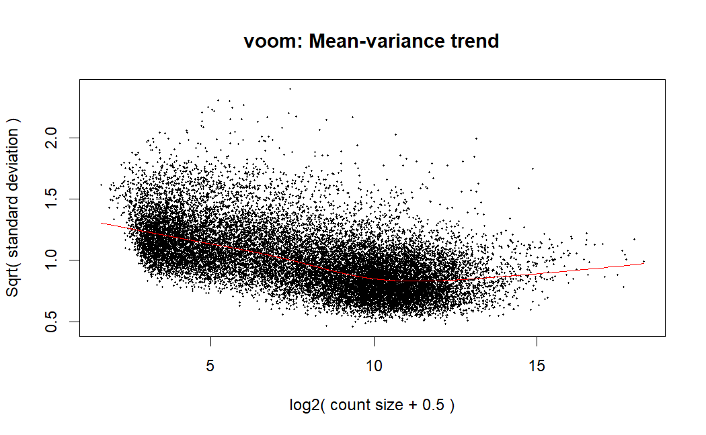
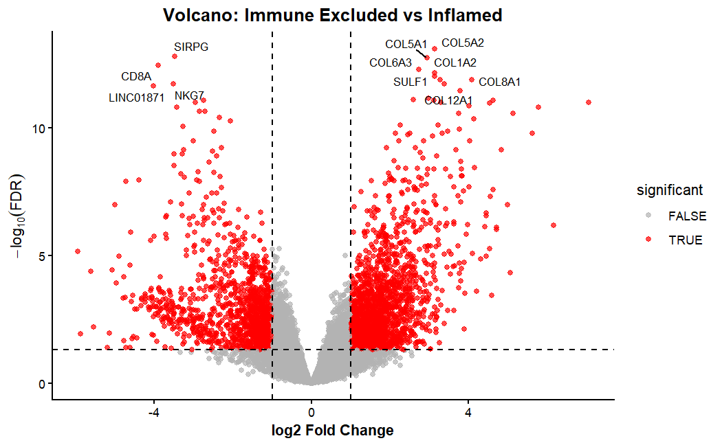
Slide 6 — Differential Expression (Excluded vs Inflamed)
limma-voom on STAR counts
FDR and fold-change thresholds
Results:
Significant genes: 3312
Strict set (FDR < 0.01, |logFC| > 1.5): 1356

Slide 7
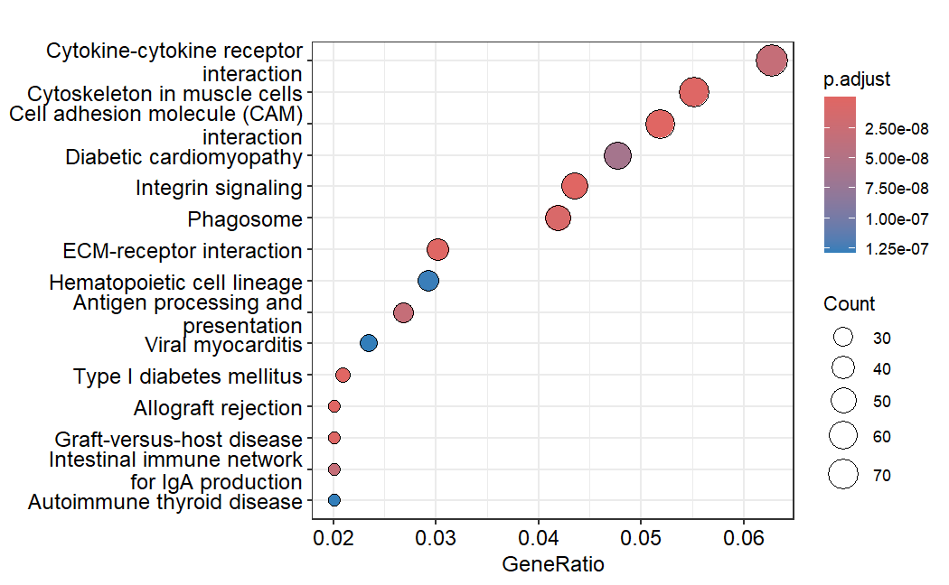
Slide 7 — Enrichment (what biology is showing)
Show dotplot (GO BP and/or KEGG). In bullets: the top themes you actually observed (e.g., ECM organization, TGF-β/WNT-related processes, immune signaling).

Slide 8
Building the prognostic signature (TCGA)
Survival preprocessing:
Removed time ≤ 0 (Cox requirement)
TCGA samples with survival: 665, events: 140
Feature selection:
Univariate Cox ranking
Top 300 entered LASSO Cox
Model selection:
Chose lambda giving 13 genes (parsimony + stability)

Slide 9
TCGA Discovery Performance (Key Numbers)
Continuous Cox
HR = 21.6
95% CI: 11.27–41.39
p < 2e-16
C-index ≈ 0.702
(Show TCGA KM plot High vs Low.)

Slide 10
External Validation (GSE39582)
Gene mapping:
Probe → gene symbol (GPL570)
Collapsed probes to gene-level (mean)
Matched 12/13 genes
Validation cohort:
n = 573, events = 190
Continuous Cox:
HR = 1.98
95% CI: 1.23–3.19
p = 0.005
C-index ≈ 0.556 (Show validation KM plot.)

Slide 11
Independence from Stage + Incremental Value
Multivariate (risk + stage)
risk_score HR = 1.90
95% CI: 1.16–3.13
p = 0.011
C-index combined ≈ 0.662
C-index comparison (validation cohort)
Stage only: 0.634
Signature only: 0.556
Stage + signature: 0.662

Slide 12
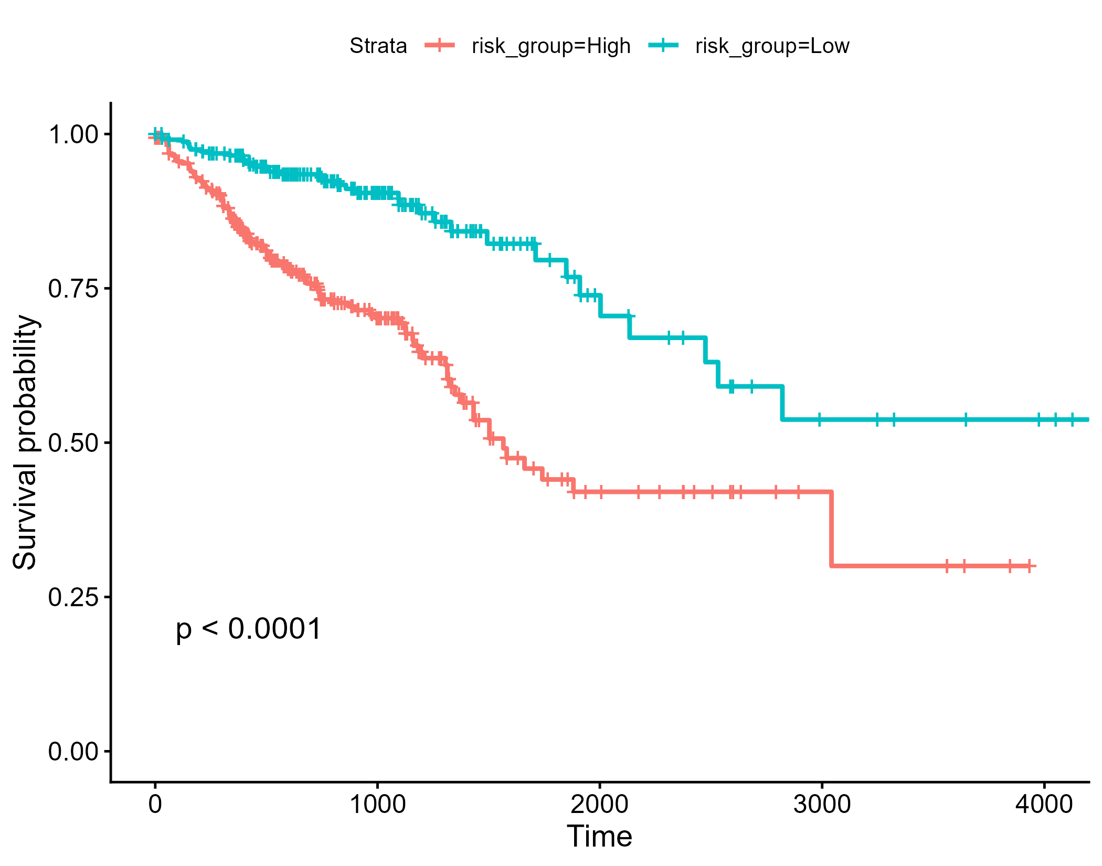
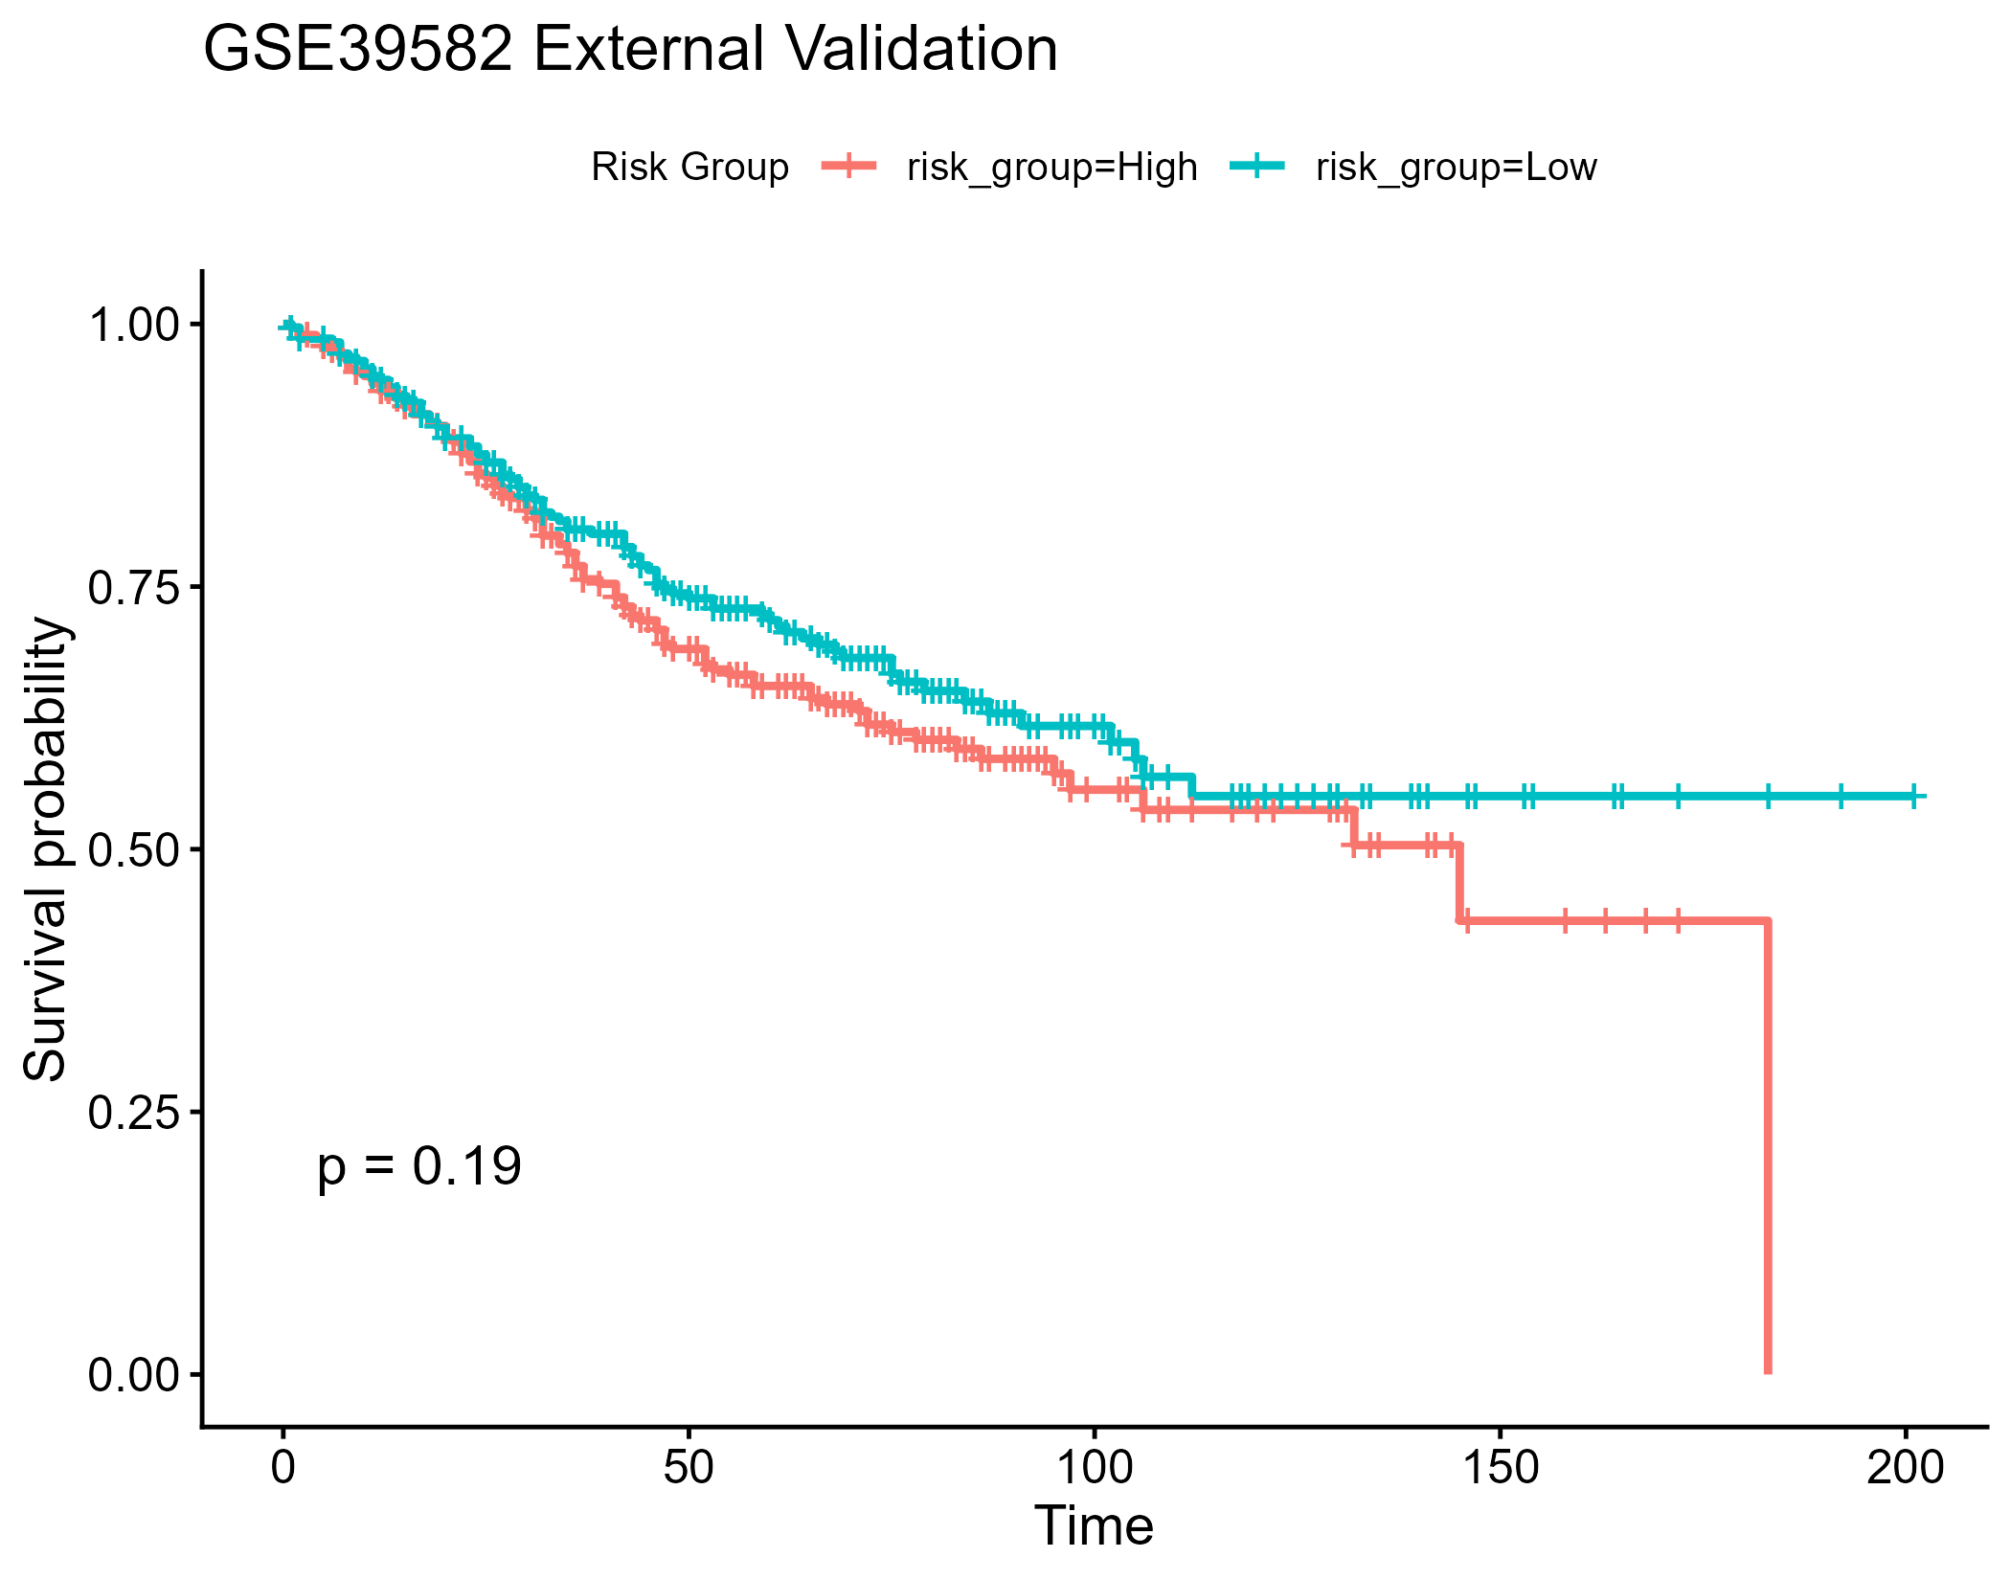
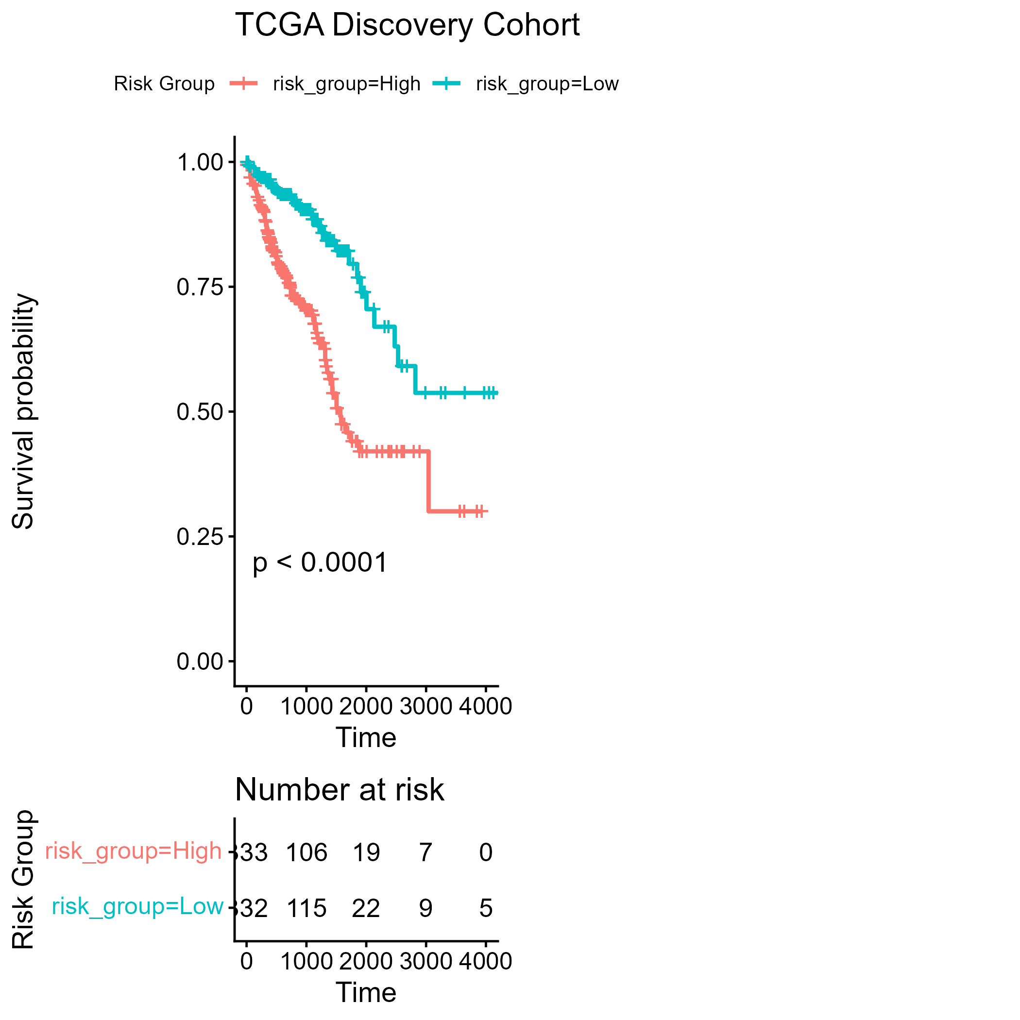

Slide 13
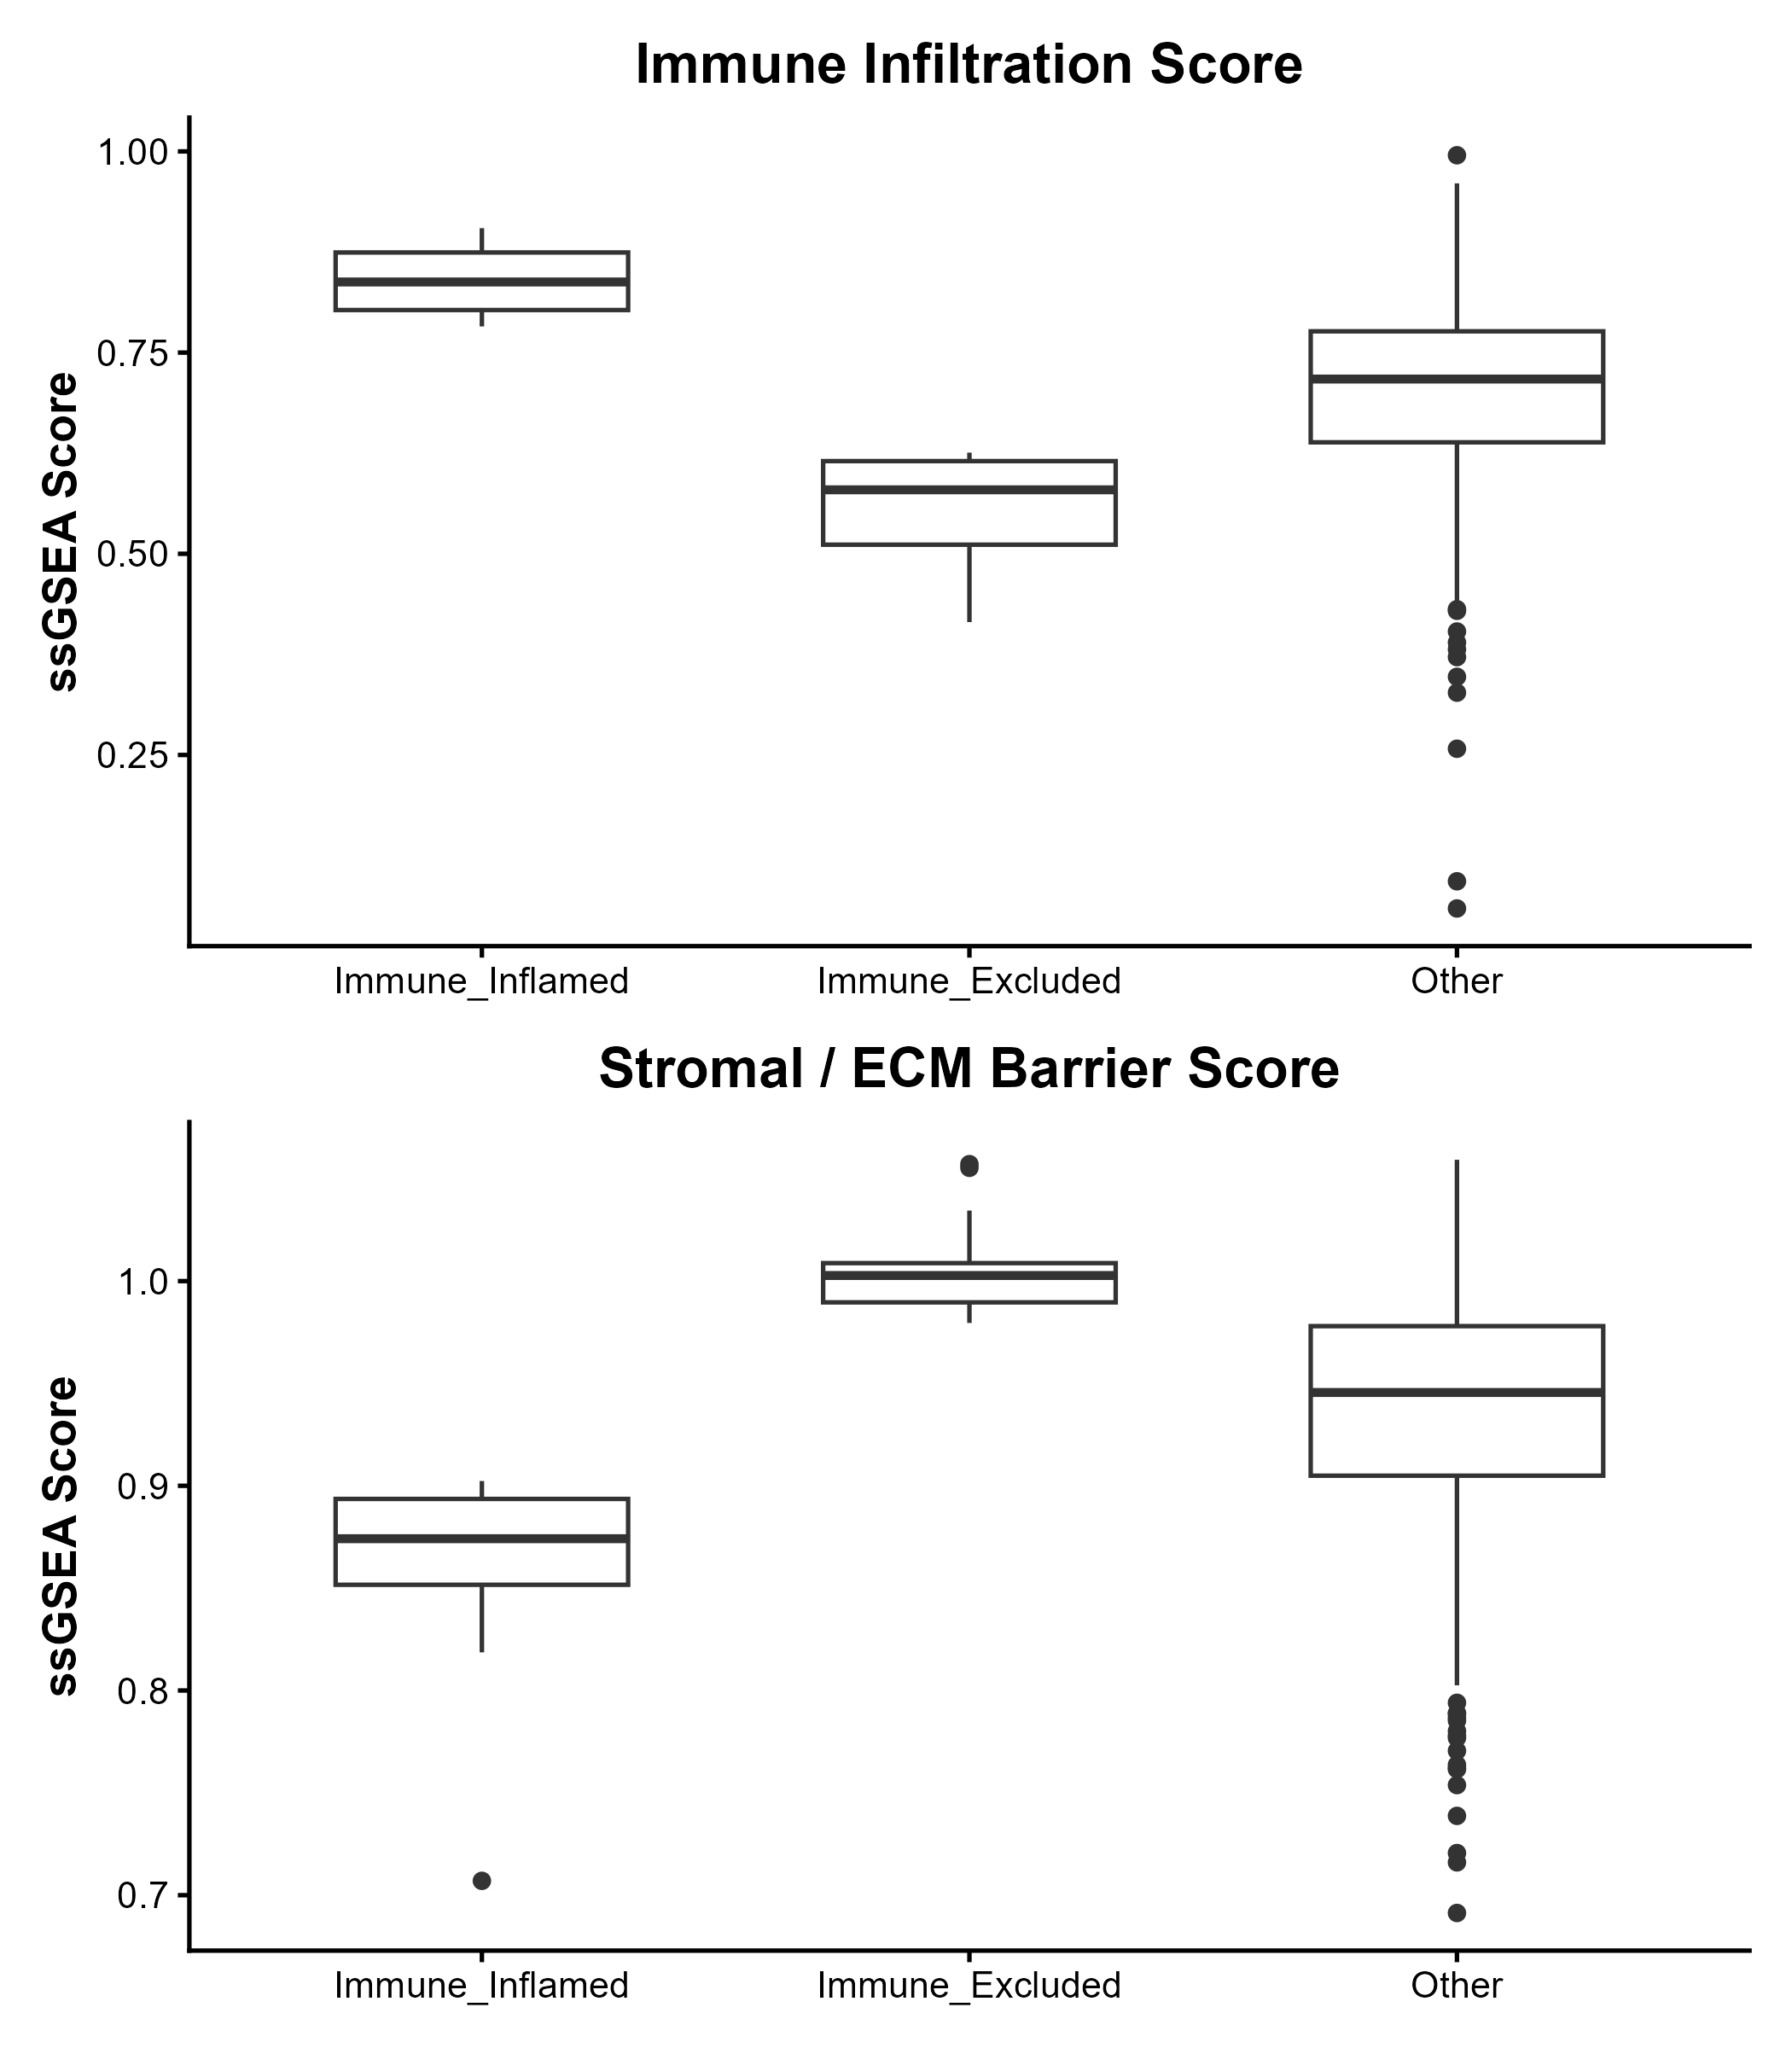
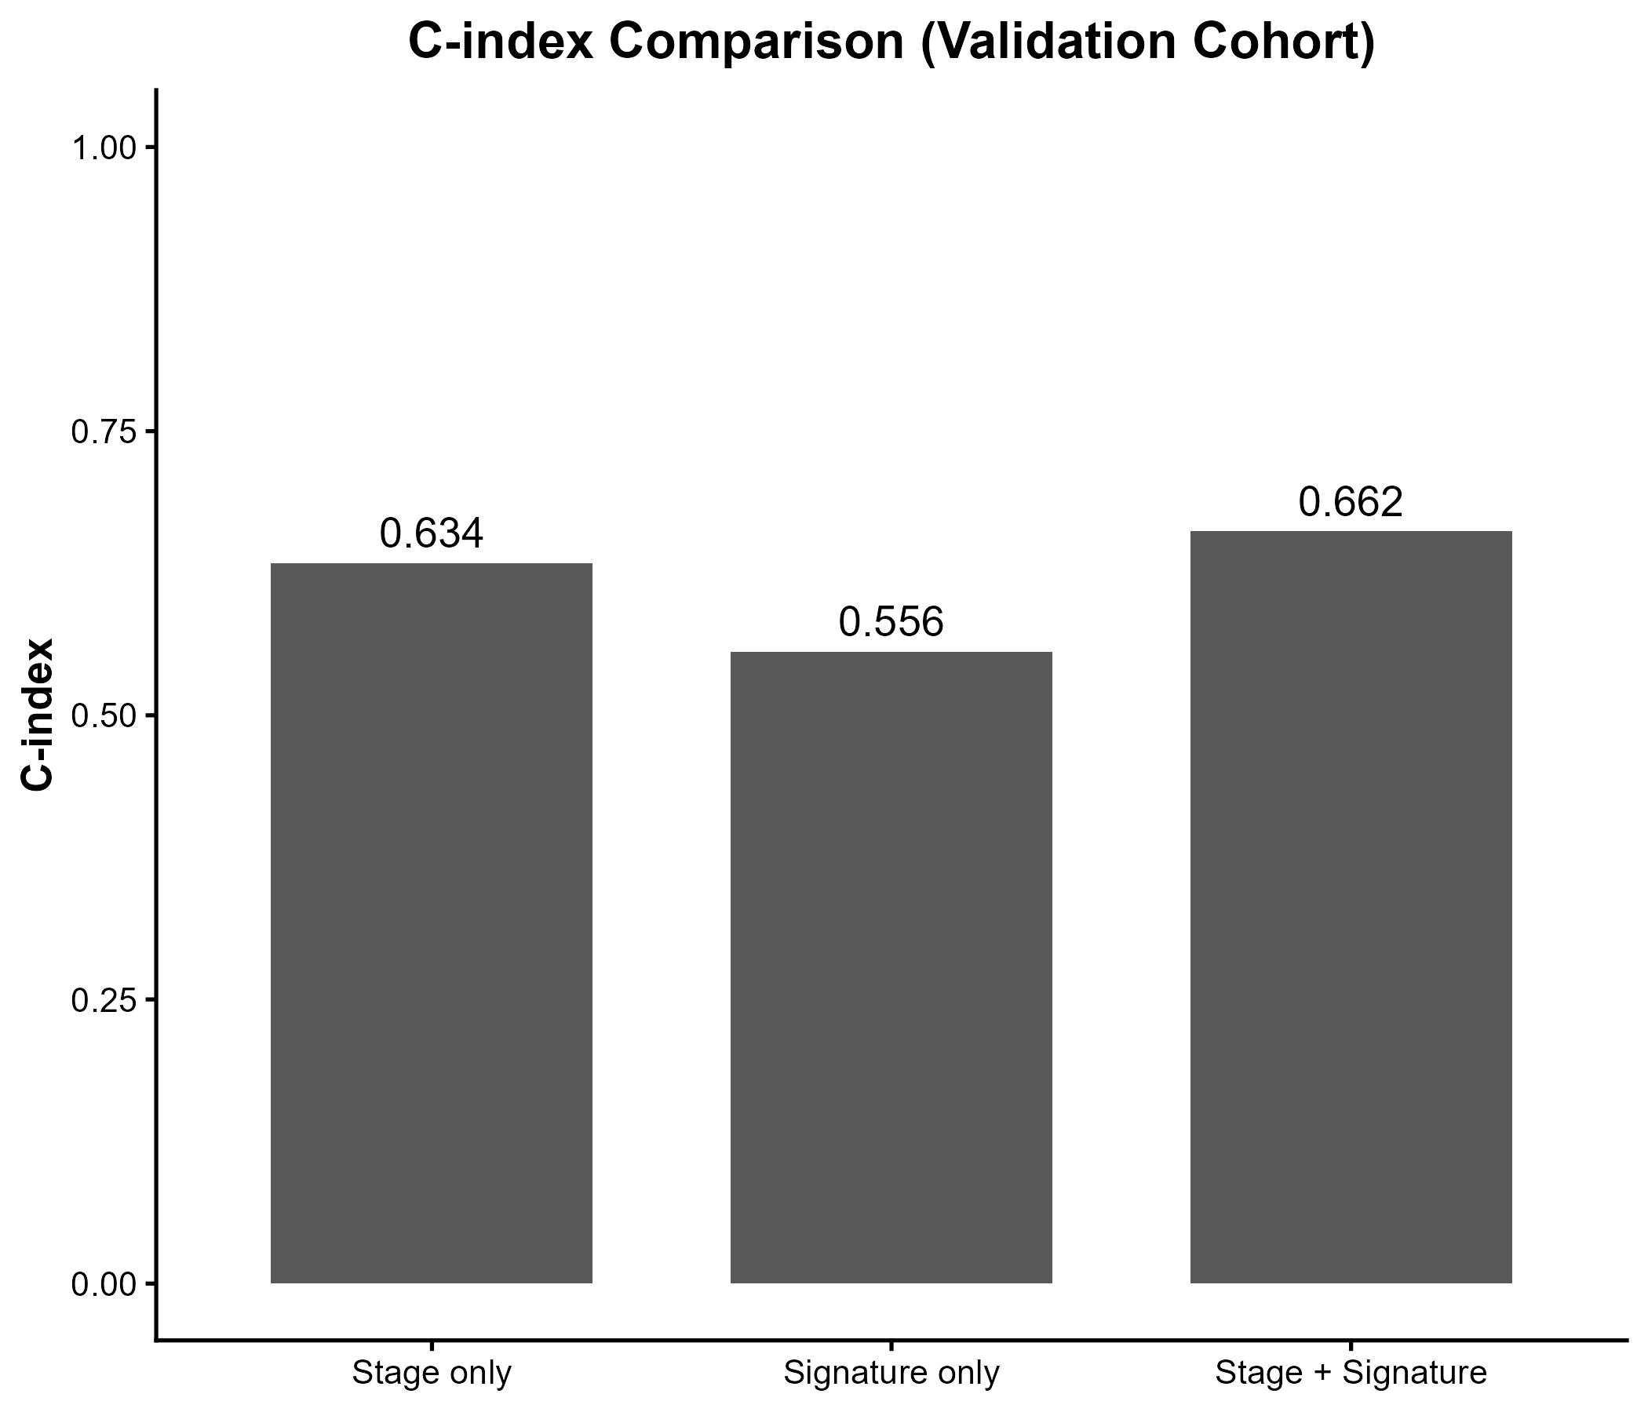

Slide 14
Conclusions + Next steps
Conclusions
Defined immune exclusion using ssGSEA immune/stromal axes
Identified exclusion-associated DE genes
Built a compact 13-gene prognostic signature in TCGA
Validated externally in GSE39582 and remains significant
Adds prognostic value beyond TNM stage
Next steps
Time-dependent ROC (1/3/5 yr AUC) in both cohorts
Report calibration (optional)
Biological interpretation: brief literature links for top genes (WNT5A, INHBB, XCL1 etc.)
Sensitivity analyses: different cutpoints (tertiles), or continuous-only reporting
Package your code as a reproducible RMarkdown + Git repo

